Slide 1
Data Type
Paul Kim

Slide 2
Data Types
Data refers to value/group of values in programming
Ex. 1, 4, 1.56, “Paul Kim”, [1,3,5] …
Then, what is data type?
Something that describes features of data
Let computer know how data can be handled
Something that defines behavior of operator
In this slide, will study concepts regarding data type.
Why?
Notes:
Describes Numeric data without decimal places

Slide 3
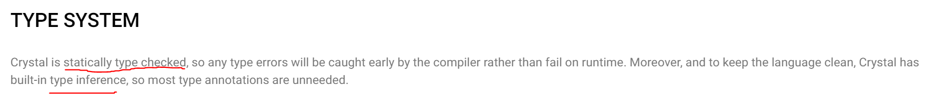
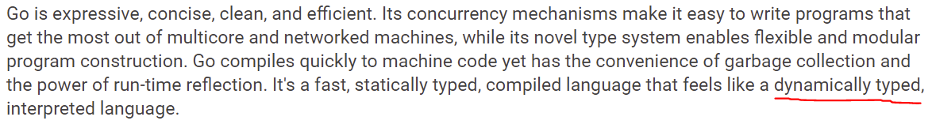
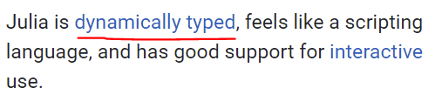
Data Types
Programming language documents usually include terminologies regarding type.
https://crystal-lang.org/
https://golang.org/
https://julialang.org/

Slide 4

Data Types
This slide will help to understand those concepts
Type Inference?
Statically Typed?
Dynamically Typed?
https://proofthatblog.com/2013/07/01/the-question-is-what-happened-to-the-question-mark/

Slide 5
Data Types
What kind of types we have?
Primitive Data Types
Composite Data Types

Slide 6
Primitive Data Types
Data type that represents single value
Integer: Numeric value with no decimal places
1, 4, 7, 15…
Floating Point: Numeric value with decimal places
1.567, 2.986, 3.14…
Character: Single character in text
‘a’, ‘c’, ‘+’, ‘$’…
Boolean: Logical value like true/false

Slide 7
Composite Data Types
Data type that represents group of values
Array: Sequence of values. Accessed by index
Tuple: Sequence of values with fixed range
Dictionary: Unordered group of key-value pairs.
String: Array of Characters
Set: Unordered group of values without duplicates
Object (Class): Group of data fields and methods

Slide 8
Variable Type
In assignment statement,
Variable = Value (ex. testVar = 125)
Variable also has type like data ( int, float…)
Based on how we declare variable,
Variable type is determined in different way
Explicit variable declaration
Implicit variable declaration

Slide 9
Explicit Variable Declaration
Programmer declares variable type
ex. int testVar = 5, String testStr = “Hello”, float x
Determines type of value that variable can have
int testVar = “Hello” → Error
Advantage: Provides readable code
Disadvantage: Needs to pay attention when declaring variable with type

Slide 10
Implicit Variable Declaration
Programmer does not declare variable type
ex. var testVar = 5, testStr = “Hello”, var x
Variable type is determined based on data type
Advantage: Does not need to pay attention when declaring variable → faster programming
Disadvantage: Somewhat not readable code

Slide 11
Type checking
Process of checking type-errors
Are types matched up correctly?
int testVar = “Hello”
int result = 15 * “abc”
String testResult = 14 * 150

Slide 12
Type checking
When to perform type checking?
Static Type Checking
Dynamic Type Checking
How seriously are type-errors handled?
Strong Type Checking
Weak Type Checking

Slide 13
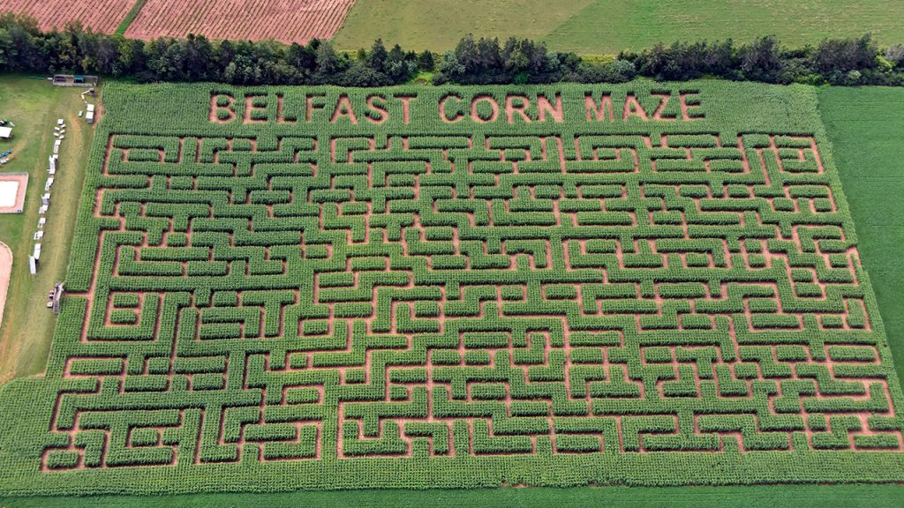

Static Type Checking
Type checking is performed at compiled time
What does it mean by ‘checking at compiled time’?
Like looking at whole corn maze from top view before playing
Looks at whole code and checks types everywhere
error
error
error
error
https://www.todaysparent.com/family/activities/best-pumpkin-patches-and-corn-mazes-in-canada/

Slide 14
Static Type Checking
Type checking is performed at compiled time
What does it mean by ‘checking at compiled time’?
Like looking at whole corn maze from top view before playing
Looks at whole code and checks types everywhere
//Java
int a = 15;
String testVar = “Hello”;
if(a == 1)
{
testVar = 125; //Error
}
Will not be called, but still gives error

Slide 15
Static Type Checking
In Static Type checking,
Once variable type is fixed, it cannot be changed later
//Java
int testVar = 15;
testVar = “Hello”; //Error
//testVar’s type cannot be changed to String

Slide 16
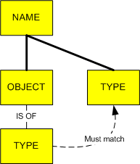
Static Type Checking
https://android.jlelse.eu/magic-lies-here-statically-typed-vs-dynamically-typed-languages-d151c7f95e2b

Slide 17
Static Type Checking
Statically Typed Language
C
C++
C#
Java
Rust
.
.
.
.

Slide 18
Type checking
When to perform type checking?
Static Type Checking
Dynamic Type Checking
How seriously are type-errors handled?
Strong Type Checking
Weak Type Checking

Slide 19

Dynamic Type Checking
Type checking is performed during run time
What does it mean by ‘checking during run time’?
Like walks through corn maze in first-person view
Walks through code and checks only types that are encountered
error
error
https://newtownmoms.com/corn-mazes-where-to-go-when/

Slide 20
Dynamic Type Checking
Type checking is performed during run time
What does it mean by ‘checking during run time’?
Like walks through corn maze in first-person view
Walks through program and checks only types that are encountered
#Python
a = 15
if(a == 1)
{
testVar = 15 + ”hello” //No Error
}
Will not be called (encountered), so no error.

Slide 21
Dynamic Type Checking
In Dynamic Type checking,
Variable type can be changed later
#Python
testVar = 15
testVar = “Hello” //No Error
testVar = [1,4,5] //No Error

Slide 22
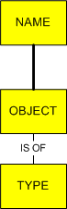
Dynamic Type Checking
https://android.jlelse.eu/magic-lies-here-statically-typed-vs-dynamically-typed-languages-d151c7f95e2b

Slide 23
Dynamic Type Checking
Dynamically Typed Language
Python
JavaScript
Ruby
Perl
PHP
.
.
.
.

Slide 24
Dynamic Type Checking
Dynamically typed languages have implicit variable declaration
Dynamic Type Checking → Implicit Variable Declaration
Does it mean that languages with implicit variable declaration are dynamically typed?
Implicit Variable Declaration → Dynamic Type Checking?
NO!

Slide 25
Dynamic Type Checking
Java has implicit variable declaration (var keyword)
But it is not dynamically typed language
Variable type cannot be changed later
Type is inferred at compile time → The ability of the inference is called Type Inference.
//Java
var testVar = 15 //testVar’s type → int
testVar = “Hello” //Error

Slide 26
Static Typing vs Dynamic Typing
Static Typing
Advantage: Build stable program with fewer errors
Disadvantage: Strict grammar in programming
Dynamic Typing
Advantage: Easier programming
Disadvantage: Risk of having more errors in program

Slide 27
Type checking
When to perform type checking?
Static Type Checking
Dynamic Type Checking
How seriously are type-errors handled?
Strong Type Checking
Weak Type Checking

Slide 28
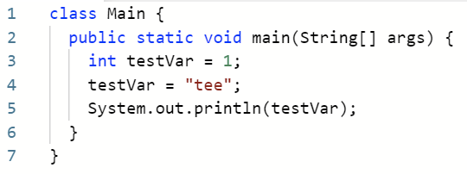

Strong Type Checking
When type-errors occur, strong type checking system gives error message
Java
Error Message

Slide 29
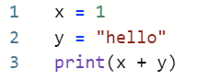
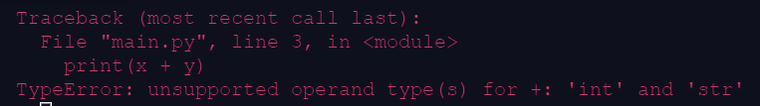
Strong Type Checking
When type-errors occur, strong type checking system gives error message
Python
Error Message

Slide 30
Strong Type Checking
Strongly typed languages
C#
Java
Scala
Python
Ruby
.
.
.
.

Slide 31
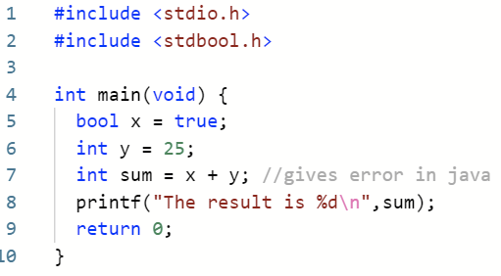
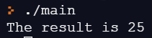
Weak Type Checking
When type-errors occurs, weak type checking system does not give error message
Instead, convert types implicitly in a way that type-errors are resolved
C

Slide 32
Weak Type Checking
In C, when char and bool work with int, char and bool are converted to int
char →ascii code
true→1,
false→0
1 + ‘b’ → 1 + 98,
23 * ‘c’ → 23 * 99
1 + true → 1 + 1
35 * false → 35 * 0

Slide 33
Weak Type Checking
Weakly typed languages
C
C++
PHP
JavaScript
Perl
.
.
.
.

Slide 34
Strong Typing vs Weak Typing
Strong Typing
Advantage: Easy to know whether there are errors
Disadvantage: Slow production time
Weak Typing
Advantage: Fast production time
Disadvantage: Hard to fix program

Slide 35
One more thing (Duck Typing)
In dynamically typed language,
Looks like variable can have any type freely
No constraint on variable type at all?
Dynamically typed language uses duck typing to give constraint on variable type
#Python
testVar = 15 //int
testVar = “Hello” //string
testVar = [1,4,5] //list

Slide 36
One more thing (Duck Typing)
Duck Typing
Checks whether variable type is suitable in surrounding context (a.k.a. certain methods and/or properties)
Duck typing is originated from duck test
"If it walks like a duck and it quacks like a duck, then it must be a duck“
Observes its characteristics to identify its subject
Notes:
If variable walks like a duck and variable quacks like a duck, then its type must be a duck

Slide 37
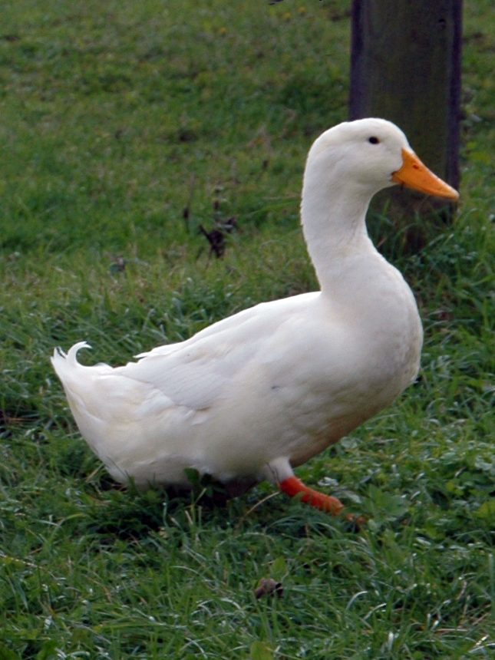

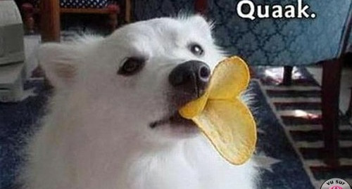
One more thing (Duck Typing)
Interest thing of duck typing is its flexibility
“If it walks like a duck and it quacks like a duck, then it must be a duck”
Duck!
Duck…!
Duck…?!
Quack!
https://www.linkedin.com/pulse/applying-duck-typing-c-marlon-gonz%C3%A1lez-g%C3%B3ngora
https://en.wikipedia.org/wiki/American_Pekin
http://www.tcafe2a.com/bbs/board.php?bo_table=c_heal&wr_id=6097&page=2229
All things are assumed as a duck because they all walk like a duck and quack like a duck.

Slide 38
One more thing (Duck Typing)
When function is defined in static typing system,
Types of input parameters are fixed
If input value is not integer, it will give error
//Java
static void testFunc(int x){
//blah blah blah…
}
public static void main(String[] args){
testFunc(15); //No error
testFunc(“Hello”); //Error
}

Slide 39
One more thing (Duck Typing)
When function is defined in dynamic typing system,
Types of input parameters are not fixed
Any type of value can be input as x
#Python
def testFunc(x):
#blah blah blah…

Slide 40
One more thing (Duck Typing)
When function is defined in dynamic typing system,
Types of input parameters are not fixed
Any type of value can be input
But what if testFunc calls reverse() of x?
#Python
def testFunc(x):
x.reverse()

Slide 41
One more thing (Duck Typing)
By duck typing,
If x has reverse(), type of x must be valid type to good to go. (It is duck!)
If not, error!
#Python
def testFunc(x):
x.reverse()
testFunc([1,2,5]) //Duck
testFunc(154) //error
Only value with reverse() can be assigned to x

Slide 42
One more thing (Duck Typing)
Assume that we define function with len()
By duck typing,
If x works with len(), type of x must be valid type to good to go. (It is duck!)
If not (ex. int), error!
#Python
def returnLen(x):
return len(x)
returnLen(“Hello”) //Duck
returnLen([1,5,7]) //Duck
returnLen(152) //Error
Only value that works with len() can be assigned to x

